Slide 1
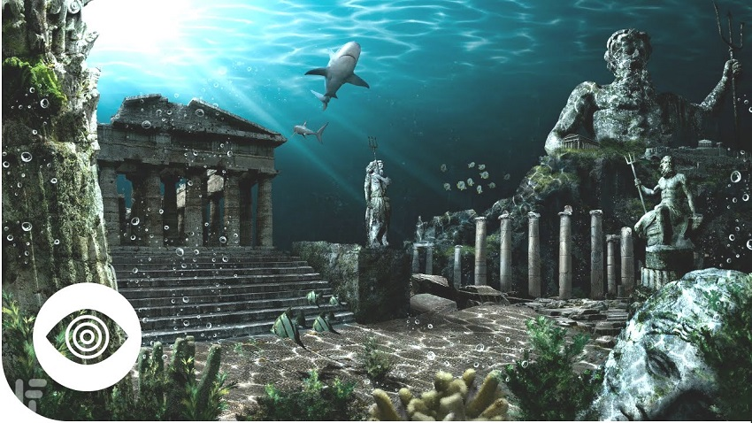
a sacred place in mythology: Atlantis
A sacred place in mythology

Slide 2
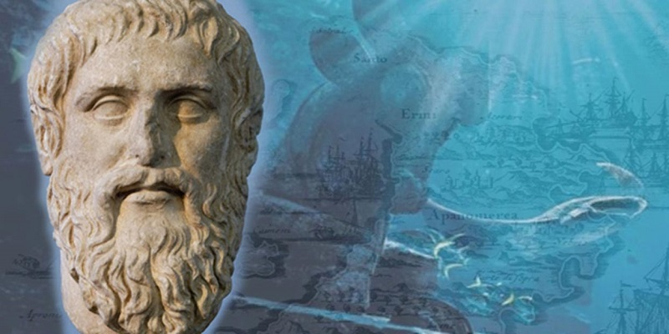
Mythological Origin
Atlantis is a legendary city depicted in the work of Greek philosopher Plato (c. 429-347).
The dialogs of Tiameus and Critias, provide an account of the legendary island of Atlantis (Annas, 2010).
The continent was present nearly 10,000 years ago outside the Pillars of Heracles
The Timaeus dialogs positions the island in the Atlantic Ocean.
Fig1: Plato and Atlantis(Source: mythology.net /)
Notes:
Atlantis is a legendary city depicted in the work of Greek philosopher Plato (c. 429-347). In two of his works, the dialogs of Tiameus and Critias, provide an account of the legendary island of Atlantis. Based on these texts, the high Egyptian priest of Sais spoke to Solon about Atlantis, a continent that was present nearly 10,000 years ago outside the Pillars of Heracles, which is currently Gibraltar. The Timaeus dialogs positions the island in the Atlantic Ocean.

Slide 3
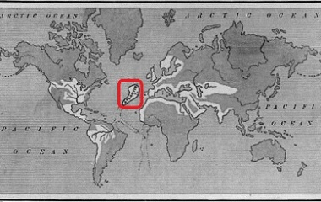
History
Atlantis was located in a historical location at the Greek island of Santorini.
Atlantis is considered an island that was large beyond Libya and Asia Minor combined
Atlantis is somewhere in the middle of Europe and American
Additional proposals position Atlantis in Indonesia, Greece, and Antarctica Cornford, F. M. (2014).
Historians and archaeologists located evidence—a swampy prehistoric city position in the cost part of Spain; a formation of an undersea rock forming in the Bahamas.
Fig2: Map of Atlantis (Source: mythology.net/)
Notes:
Plato’s Atlantis was located in a historical location at the Greek island of Santorini. Atlantis is considered an island that was large beyond Libya and Asia Minor combined position in the Atlantic beyond the Pillars of Hercules. In the Hypothesis, Atlantis is somewhere in the middle of Europe and American, but others have suggested additional proposals some of which position Atlantis in Indonesia, Greece, and Antarctica Historians and archaeologists located evidence—a swampy prehistoric city position in the cost part of Spain; a formation of an undersea rock forming in the Bahamas.

Slide 4
Functions of The Place
Atlantis was involved an advanced form of civilization
A paradise based on Plato’s description.
The inhabitants had great power and greatly opposed Asia and Europe
They were capable of navigating the sea.
A massive fight is mentioned between the goddess Athena and Athenians.
Notes:
Atlantis Involved an advanced form of civilization, with wealth and abundance in everything—a paradise based on Plato’s description. The inhabitants had great power and greatly opposed Asia and Europe, and they were capable of navigating the sea. A massive fight is also mentioned between the goddess Athena and Athenians. The Athenians won the battle and protected Athens.

Slide 5
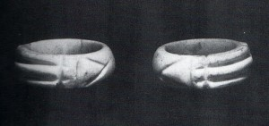
Sacred Objects
One of the most significant sacred object is the Atlantis Ring which was discovered around 1860s in the Valley of the Kings in Egypt (Godwin, 2010).. The ring was adorned with geometric symbols that were positioned and balanced based on special arrangements. The ring also has significant symbolism that is vital to vibration fields.
Notes:
One of the most significant sacred object is the Atlantis ring which was discovered around 1860s in the Valley of the Kings in Egypt. The ring was adorned with geometric symbols that were positioned and balanced based on special arrangements. The ring also has significant symbolism that is vital to vibration fields.

Slide 6
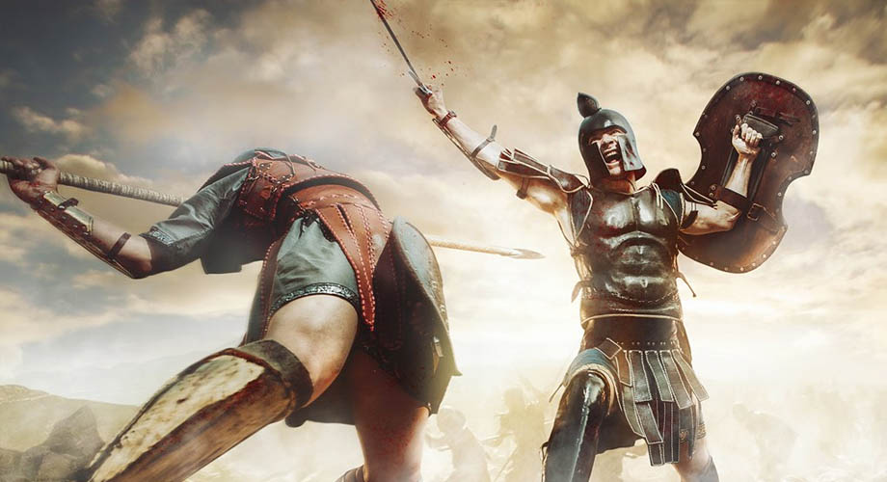
Sacred Attributes
The Athenians had the ability of defending themselves through powerful forces. Meanwhile, according to Plato Atlantis is a piece of subcontinent land which had technological advancement but at the same time had moral inadequacy since it tried dominating the world.
Notes:
The Athenians had the ability of defending themselves through powerful forces. Meanwhile, according to Plato Atlantis is a piece of subcontinent land which had technological advancement but at the same time had moral inadequacy since it tried dominating the world.

Slide 7
Symbolism of These Object
The Atlantis Ring symbolizes protection, and a balance of an individual’s energy field.
It benefits energetic properties helping in shielding the aura and reducing the effects of frequencies that might be harmful.
It aids the circulation and the destruction of healing energy all through a person body.
The ring is powerful because it has been worn severally and is well known worldwide.
It increases the ability of tapping into a person’s intuitive powers
The ring has several names and has invisible cosmic energy surrounding it.
Notes:
The Atlantis Ring is important in that it symbolizes protection, and a balance of an individual’s energy field. It benefits energetic properties, which help in shielding the aura and reducing the effects of frequencies that might be harmful. It also aids the circulation as well as the destruction of healing energy all through a person body and an individual’s energy field

Slide 8
Comparison of Atlantis
Similarities have existed among different ancient cultures as well as significant differences.
Sun worship and Flood myths, for example are based on shared teachings or they may have a distinct separation in terms of reactions to destructive and beneficent elements of nature(Weil, 2011).
Pyramids were designed in Egypt and the Americas but they additionally had significant difference in structures.
The pyramid walls in the America never converged to create an actual point as did the Egypt; instead the walls reached a level on to which the platform was created
In case Atlantis fall between 8500-9500 b.c.e., it is important to ask the accounts of long time lag for the erection of Egyptian pyramid.
Notes:
Similarities have existed among different ancient cultures as well as significant differences. Sun worship and Flood myths, for example are based on shared teachings or they may have a distinct separation in terms of reactions to destructive and beneficent elements of nature.
Pyramids were designed in Egypt and the Americas but they additionally had significant difference in structures. The pyramid walls in the America never converged to create an actual point as did the Egypt; instead the walls reached a level on to which the platform was created
In case Atlantis fall between 8500-9500 b.c.e., it is important to ask the accounts of long time lag for the erection of Egyptian pyramid.

Slide 9
Relevance in Contemporary Culture
Atlanteans have for long been credited for having possessed the technology of generating electricity, creating flying machines, and harness nuclear power for ware fare and energy.
These innovations were developed more than 9000 years before modernity came to existence.
Atlanteans had an adverse knowledge regarding a frightening death glimmer, levitation secrets, and a purified energy form through crystals(Joseph, 2017).
Inhabitants of the lost content had cosmic connections with extraterrestrials and may have even been a colony that came up on earth through alien explorations.
Notes:
Atlanteans have for long been credited for having possessed the technology of generating electricity, creating flying machines, and harness nuclear power for ware fare and energy. These innovations were developed more than 9000 years before modernity came to existence.
Some others have claimed that Atlanteans had an adverse knowledge regarding a frightening death glimmer, levitation secrets, and a purified energy form through crystals. Most enthusiasts hold a firm belief in the idea that the inhabitants of the lost content had cosmic connections with extraterrestrials and may have even been a colony that came up on earth through alien explorations.

Slide 10
Significance in Minds and Emotions
The lost city of Atlantis represents the greatest unresolved mystery of humankind.
Atlantis experienced several periods of legitimate complexity that stretches time, fare greater than any documented history of modern civilization.
Atlantis represents civilization
Atlantis forms part of a world culture that shows earlier civilization spanning in far remote periods.
Atlantis had a golden age.
Spirituality and science were combined in a way that was magnificent.
Despite the challenges and trials that existed it was without question a wonderful time for humankind
The development experienced today reflects the achievements of Atlantean time expressed in a grand scale.
Notes:
The Atlantis Ring is important in that it symbolizes protection, and a balance of an individual’s energy field. It benefits energetic properties, which help in shielding the aura and reducing the effects of frequencies that might be harmful. It also aids the circulation as well as the destruction of healing energy all through a person body and an individual’s energy field

Slide 11
Facts Surrounding the Culture
Atlantis had a rich soil with plenty of water, abundant animals and vegetation, and a naturally hot spring for health.
The city had plenty of gold inlaid in buildings and was the most precious stone worn as jewelry
Slaves engaged in various manual labors, which allowed an elite group to purse knowledge, engage in sport activities and improve upon the thriving society(De Camp, 2012).
There is no conclusive evidence of Atlantis but the attributes expend to include technology
The society had a strong military power and abundance of natural resources
Atlantis had spectacular building and engineering as well as intellectual achievement that advanced other lands.
In the end Atlantis was destroyed by flood and earthquake and swallowed up by the sea.
Notes:
Atlantis had a rich soil with plenty of water, abundant animals and vegetation, and a naturally hot spring for health. The city had plenty of gold inlaid in buildings and was the most precious stone worn as jewelry. Slaves engaged in various manual labors, which allowed an elite group to purse knowledge, engage in sport activities and improve upon the thriving society. There is no conclusive evidence of Atlantis but the attributes expend to include technology. The society had a strong military power and abundance of natural resources. Atlantis had spectacular building and engineering as well as intellectual achievement that advanced other lands. In the end, Atlantis was destroy by flood and earthquake and swallowed up by the sea.

Slide 12
References
Annas, J. E. (2010). The Atlantis Story: the Republic and the Timaeus. In Plato's Republic: A Critical Guide (pp. 52-64). Cambridge University Press.
De Camp, L. S. (2012). Lost Continents. Courier Corporation.
Joseph, F. (2017). Atlantis and Other Lost Worlds. Arcturus Publishing.
Godwin, J. (2010). Atlantis and the Cycles of Time: Prophecies, Traditions, and Occult Revelations. Simon and Schuster.
Cornford, F. M. (2014). Plato's cosmology: the Timaeus of Plato. Routledge.
Weil, A. (2011). The World's Most Amazing Lost Cities. Heinemann-Raintree Library.

